Slide 1
Sales & Inventory Analysis
Mini Project using Pivot Tables
Name:S.SUBAHARINI
Register Number:E720524cy030
Department:BE.(CSE).CYBER SECURITY (II)
Date:19/04/2026

Slide 2
Introduction
This project analyzes sales and inventory data using Pivot Tables.
Helps in:
- Tracking sales
- Monitoring stock
- Identifying best products

Slide 3
Dataset Overview
Includes:
- Date
- Product
- Category
- Region
- Salesperson
- Units Sold
- Unit Price
- Stock Available

Slide 4
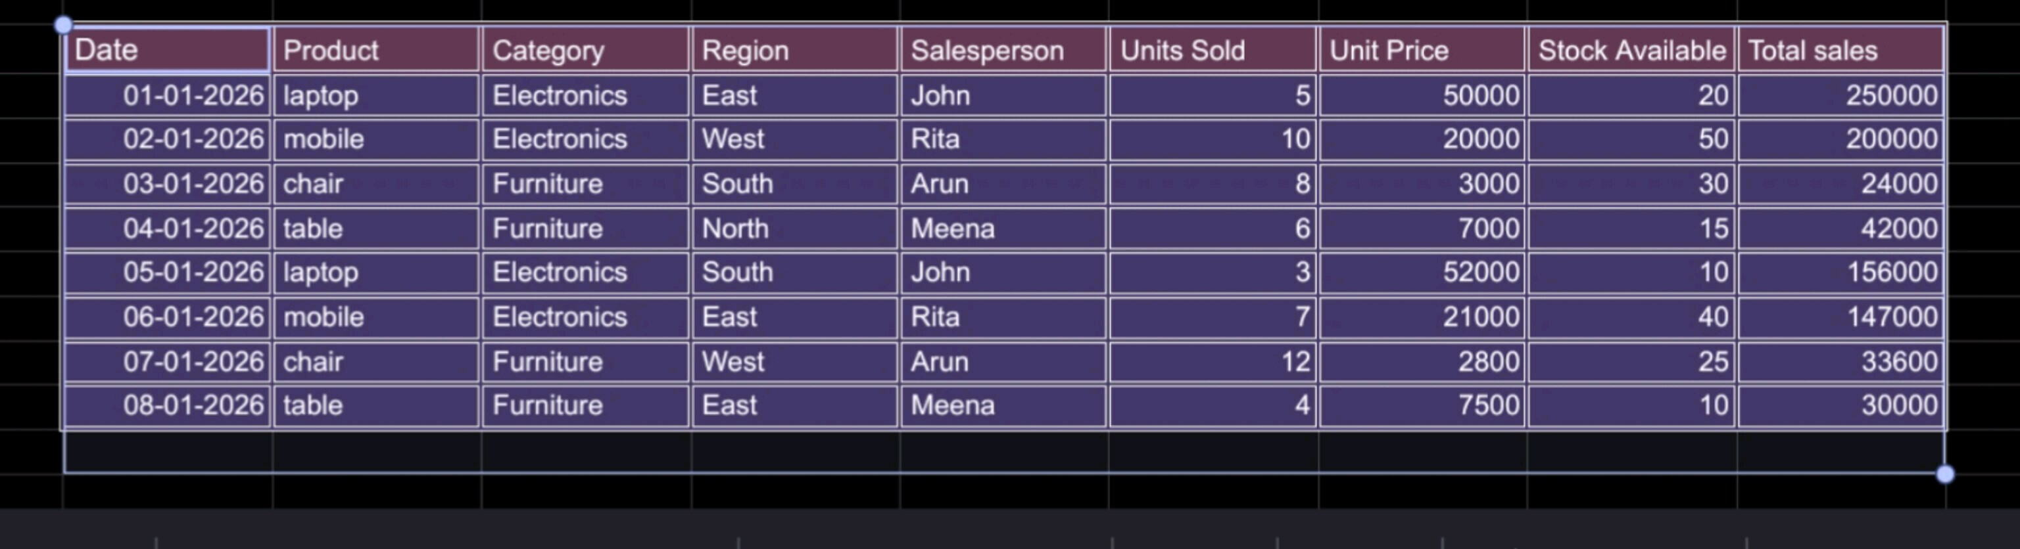
Task 1 – Sales by Product
Rows: Product
Values: Total Sales
Insight:
Laptop highest revenue
Mobile second

Slide 5
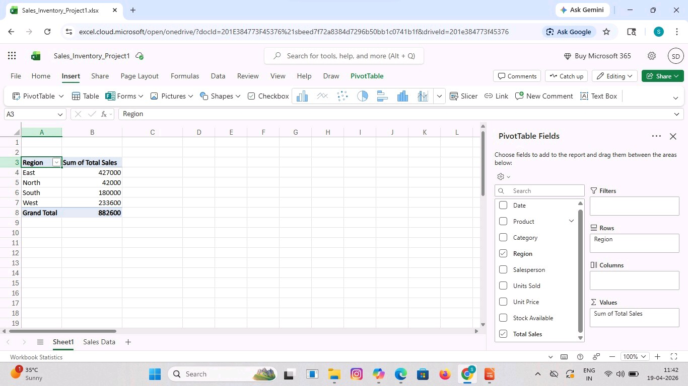
Task 2 – Sales by Region
Rows: Region
Values: Total Sales
Insight:
East best
North lowest

Slide 6
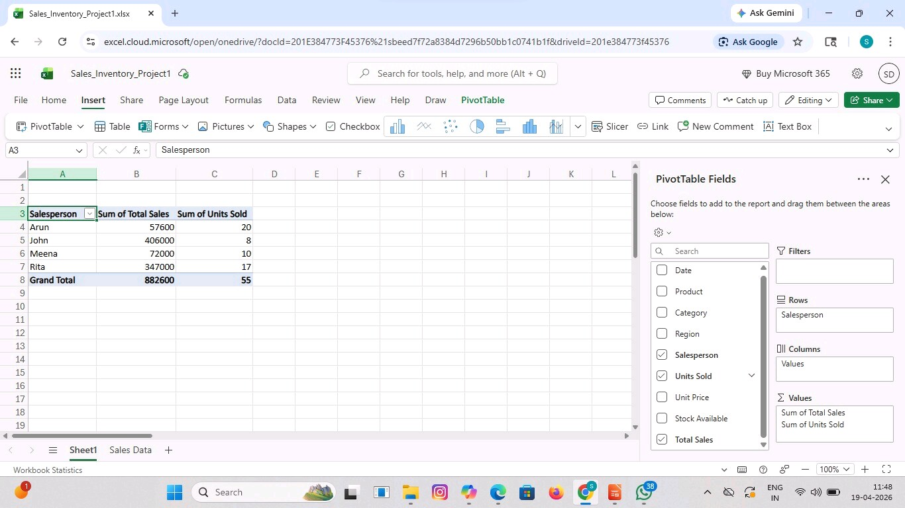
Task 3 – Salesperson Performance
Rows: Salesperson
Values:
- Units Sold
- Total Sales
Insight:
Rita more units
John high revenue

Slide 7
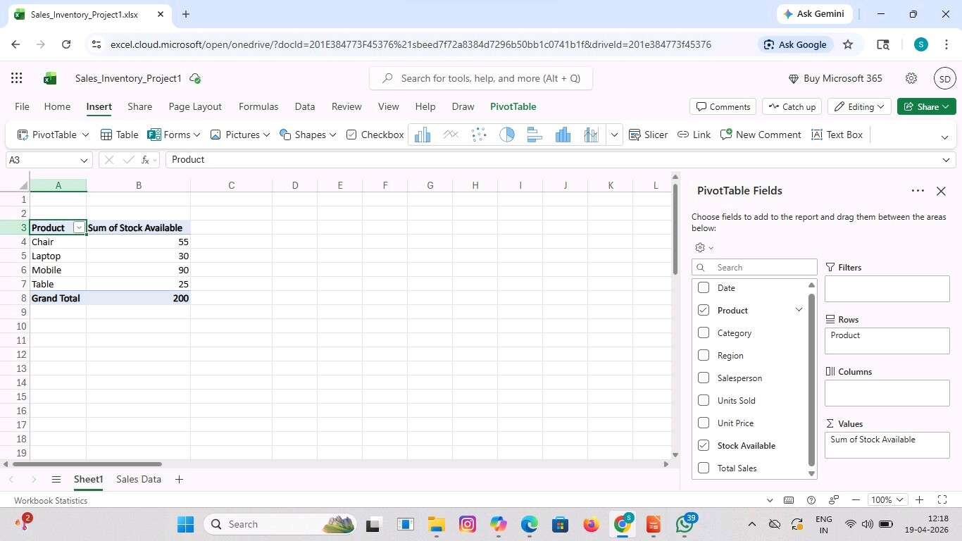
Task 4 – Inventory Analysis
Rows: Product
Values: Stock Available
Highlight stock < 20
Laptop & Table low stock

Slide 8
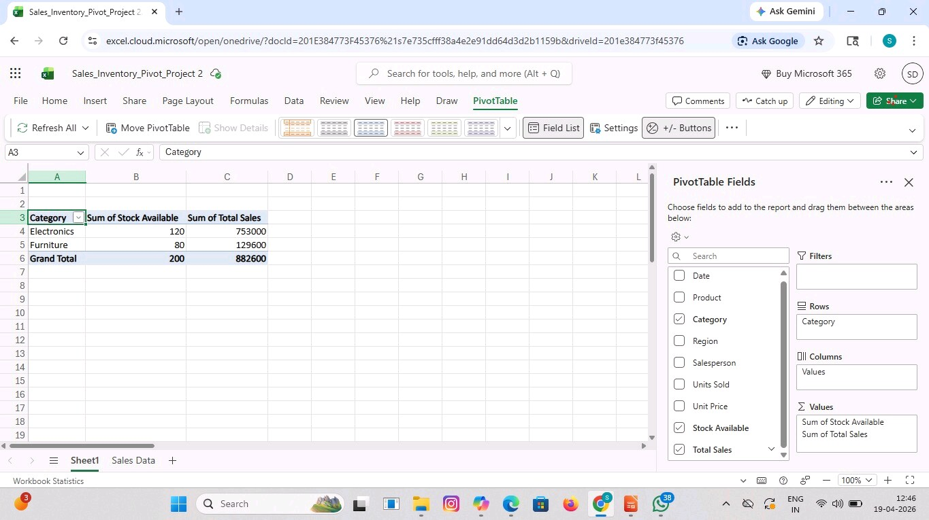
Task 5 – Category-wise Analysis
Rows: Category
Values: Total Sales
Electronics > Furniture

Slide 9
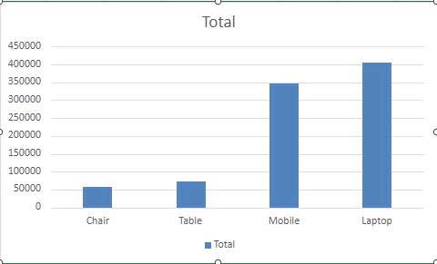
Task 6 – Pivot Charts
Column Chart: Sales by Product
Pie Chart: Category Share

Slide 10
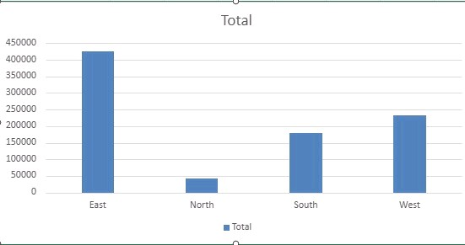
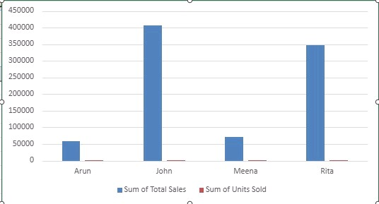
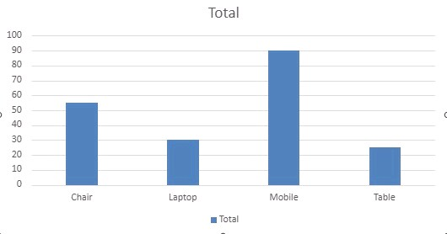
Task 7 – Slicers
Added slicers:
- Region
- Product
- Salesperson
Used for filtering

Slide 11
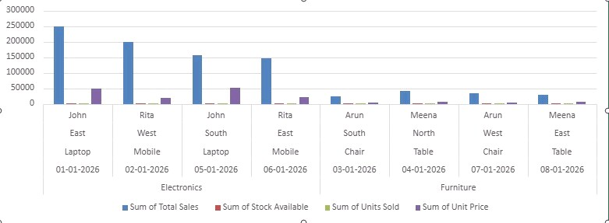
Conclusion
Pivot Tables simplify analysis
Help in decision making
Identify best product, region, stock issues

Slide 12
Thank You
Thank You!
Questions?
How can sales performance be improved in low-performing regions?
What steps can be taken to manage low inventory levels effectively?

